Slide 1
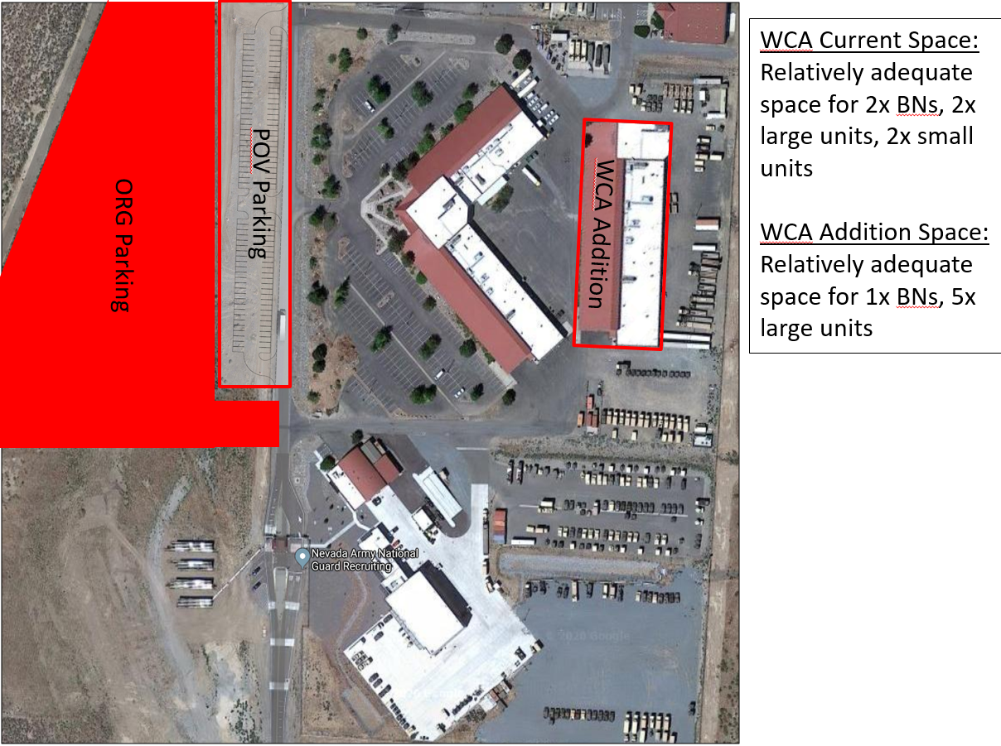
Washoe County Training Center Addition (Harry Reid Training Center) #21142
Justification:
There is currently a significant shortfall of building square footage at the Washoe County Training Center
Nevada Army Guard does not have adequate square footage for soldier staffing at the Washoe County Training Center to serve the members of the Nevada National Guard
Planning:
$5.1M
50/50 Split
$2.3M State
Construction:
$36M
50/50 Split
$18M State

Slide 2
Background
Readiness Centers
Requirement – 852,00 SF
In-state Property- 524,000 SF
Deficit – 328,000 SF
Deficit most acute in Reno and Las Vegas.
Washoe County Readiness Center Addition will add 60,000 sf to the Northern Nevada Area.

Slide 3
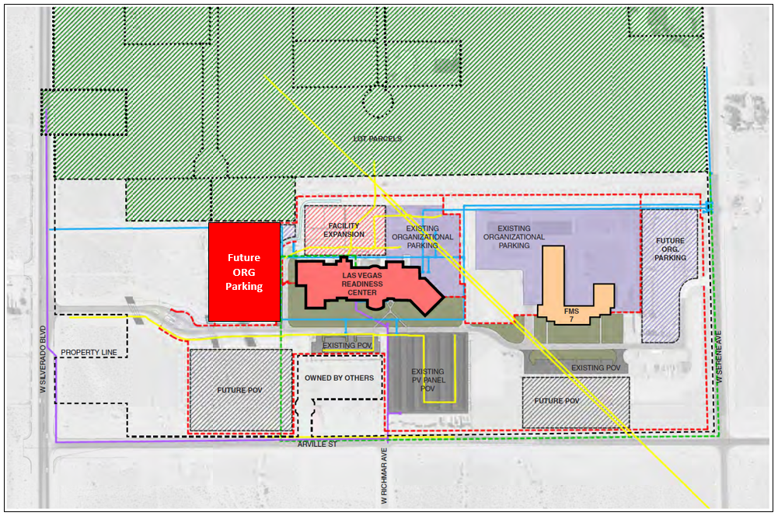
Construct Organizational Parking Addition (Las Vegas Readiness Center) ID # 21139
Justification:
Due to force realignment, two Companies are being relocated to LVRC. The current organizational parking at the LVRC is inadequate to absorb the additional rolling stock from these companies.
This project will construct additional organizational parking with lighting at the Las Vegas Readiness Center (LVRC) on Silverado Ranch Boulevard
The design for this project was funded by the Nevada Army National Guard as part of an agency project that was funded in 2020 (20-A021)
$2.8M
75/25 Split
$700K State

Slide 4
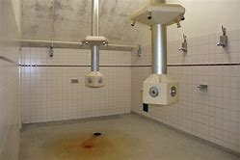
Renovate Restrooms (Clark County Readiness Center) ID # 21128
Justification:
The current facility was designed in 1995 to accommodate one battalion or 300 predominately male Soldiers. Demographic changes in the military requires the need for expanded female facilities. In addition, 600 Soldiers now train at this site.
During drill weekends the restrooms receive use well beyond intended capacity resulting in foul smells drifting from the restrooms out into the drill hall and other training areas. Soldiers have to perform hygiene, including showers, in shifts as the shower area can only accommodate about 15 at a time.
This project will bring the site up to capacity, meet code for male/female ratios and eliminate smells permeating the rest of the facility.
$1.9M
50/50
$950K State

Slide 5
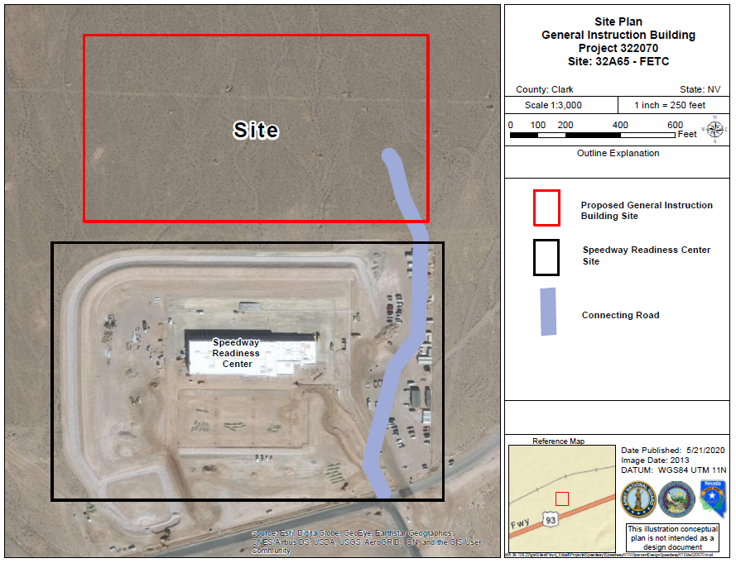
Advanced Planning General Instruction Building Design(Floyd Edsall Training Center) #21144
Justification:
This facility is required in order for the 421st RTI to maintain their accreditation in order to continue to train the National Signal NCO
Current situation is unsustainable as the diverted space is temporary and is 25% of the authorized administration and classroom space
The location of the new facility is planned to be within the Floyd Edsall Training Center, north of the Speedway Readiness Center
This is a 100% federally funded design project
$5.5M
100% Federal
$1.2M State

Slide 6
Upgrade Wastewater Treatment System (Elko County Readiness Center) ID # 21127
Justification:
The system needs to be upgraded to handle the increased occupancy of Battle Born Youth Challenge.
The existing wastewater system is designed and permitted to handle an average daily flow rate of 20,000 gallons per day. The facility is anticipated to produce an average daily flow rate of 26,000 gallons per day when Battle Born Youth Challenge is in full operation.
The original system design assumed some nitrogen treatment would take place within fire water treatment pond system which was installed when the facility was constructed but has subsequently been removed.
$ 1.3M
56/44
$600K State

Slide 7
Domestic Hot Water System and Transformer Replacement (Nevada Army National Guard - Office of the Adjutant General) #21133
Justification:
The existing domestic hot water system cannot meet domestic hot water demand
Currently, the heating hot water boilers provide all of the heating capacity for the domestic hot water needs via a heat exchanger and storage tank
The new domestic hot water system will consist of stand-alone gas-fired water heaters so the heating hot water plant will no longer be tied to domestic hot water production
The existing transformers are overloaded which results in less efficient operation, noise, and heat
$ 820K
50/50 Split
$420K State

Slide 8
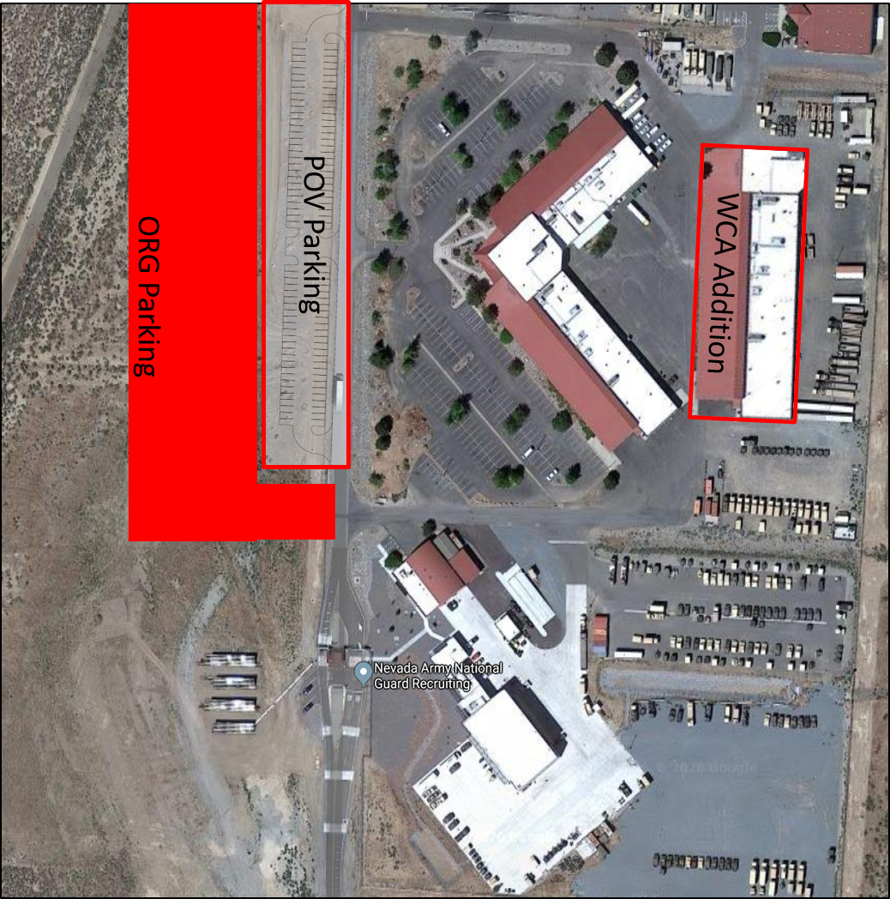
Construct Organizational Parking (Washoe County Armory) #21206
Justification:
The Organizational Parking is a new area for organizational vehicles to support the WCA add/alt
Gravel topped parking area with fencing for organizational vehicle parking at the WCA
$ 1.4M
75/25 Split
$413K State

Slide 9
Electrical Circuiting, Devices & Lighting Replacement (Plumb Lane Armory) #21130
Justification:
Replace panelboard feeders, branch circuit conductors, conduits, electrical devices, LED lighting, and lighting controls for three buildings located at the Plumb Lane Armory
The existing underground conduits have failed due to corrosion and do not provide an effective grounding pathway for the building and increase the risk of electrical shock and electrocution to personnel
Lighting is approximately 40 years old and at end of life
$ 1M
75/25 Split
$300K State

Slide 10
Advance Planning Design: Connection to Sewer System (Speedway Readiness Center) #21202
Justification:
Must have a design in order to request this project from National Guard Bureau
Provide design through construction documents for the Speedway Readiness Center to be connected to sewer
Speedway Readiness Center finished construction in 2020 and there was not sewer adjacent to the property
$381K
75/25 Split
$95K State

Slide 11
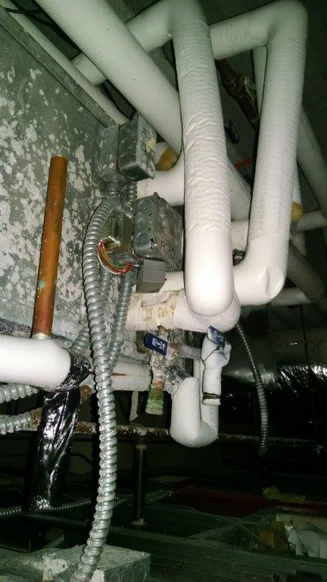
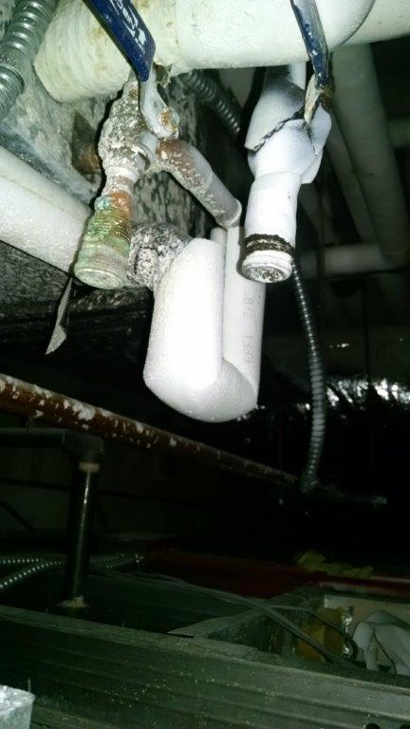
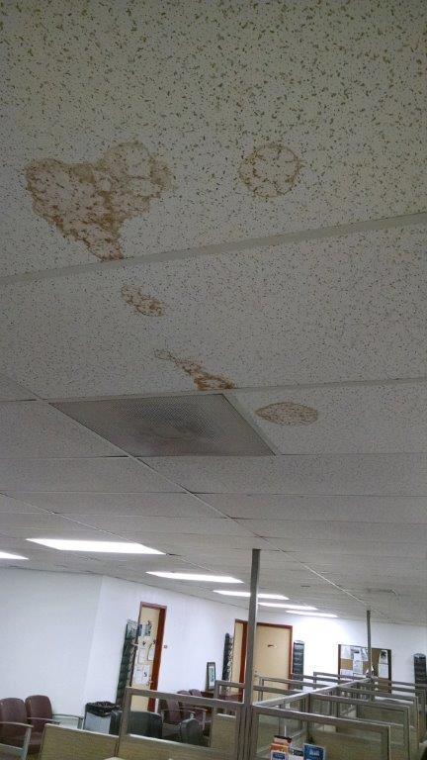
HVAC Systems Renovation (Clark County Armory) ID # 7524
Justification:
The fan coils and evaporative coolers installed at the FETC are 23 years old and are nearing the end of their useful service life.
The additional temperature controls will shut down the HVAC in areas that communicate directly with the outdoor environment to save energy when exterior doors are left open.
$1.6M
50/50
$850K State

Slide 12
Upgrade Interior Lighting (Las Vegas Readiness Center) #21136
Justification:
Replace the existing fluorescent fixtures for high efficient LED fixtures and connect the HVAC system to the lighting system, turning down the HVAC system when the space is unoccupied
Supports the intent of Senate Bill 254
$950K
75/25
$480K State

Slide 13
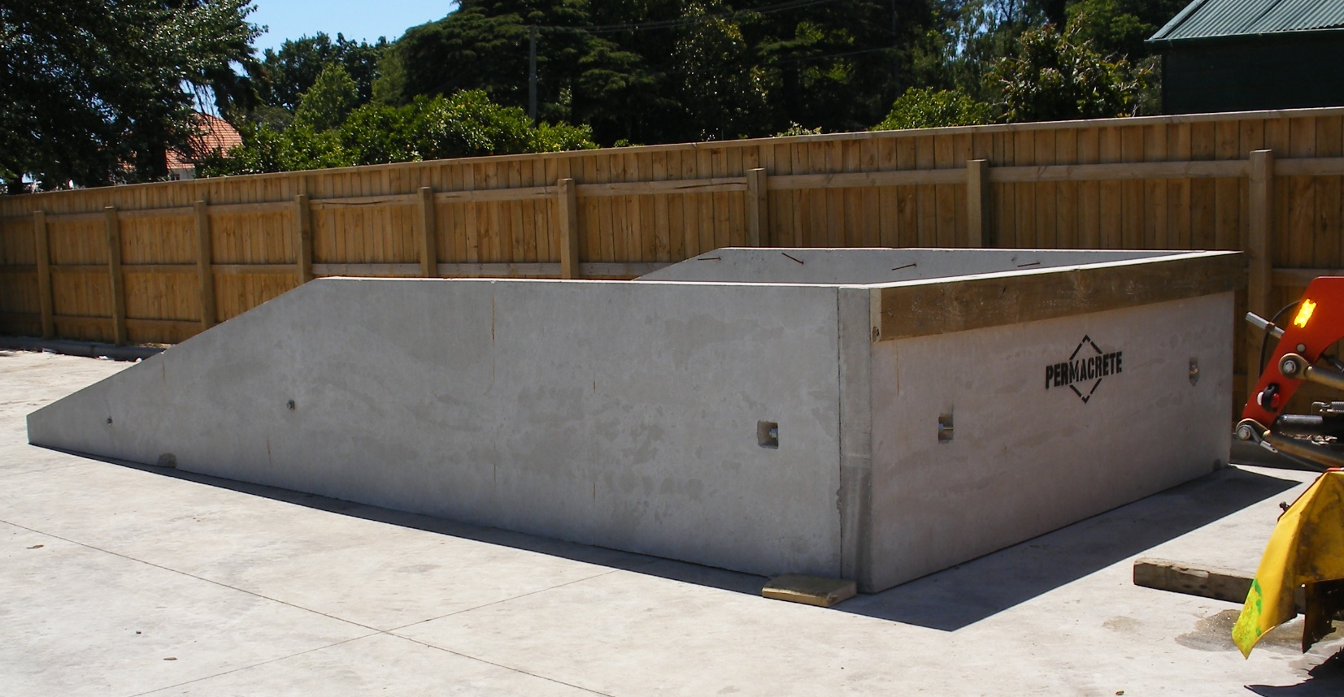
Loading Dock (N. Las Vegas Readiness Center) ID # 7586
Justification:
There is a need for a loading dock to load and unload military vehicles, cargo and shipments at the North Las Vegas Readiness Center.
There are currently 796 vehicles and trailers that will utilize this loading dock.
384 vehicles/trailers are new since moving to the facility in 2014
$480k
75/25
$120K State
Wanted

Slide 14
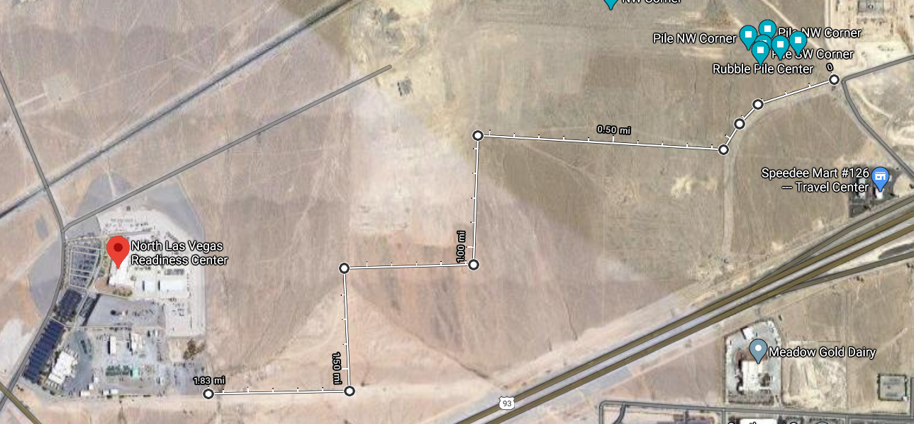
Security Fencing (Floyd Edsall Training Center) #21132
Justification:
This force protection fencing project is necessary to protect military property and to keep the public from accessing military training areas
This part of the Floyd Edsall Training Center parcel needs to be secured to prevent homeless encampments on Guard property
$1.2M
100% FED
$76k State

Slide 15
Replace Buildings 6 Overhead Doors (Carlin Readiness Center) ID # 7583
Justification:
The glass panel doors are not energy efficient and reduce overhead clearance.
The doors are not reliable and the building needs highly reliable panels and openers.
The glass panels have proven to be very poor insulator. Need heavy gauge insulated coiling doors
$ 530K
56/44
$240K State

Slide 16
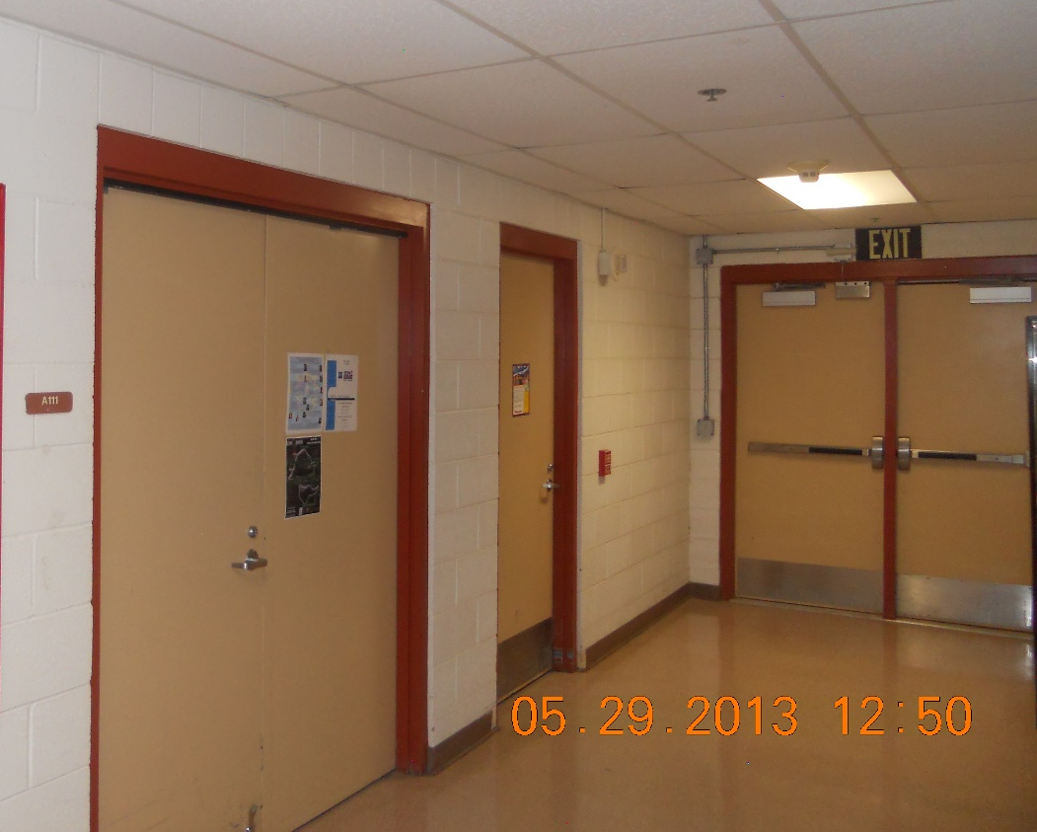
Interior/Exterior Door Replacement (Clark County Armory) ID # 19124
Justification:
The doors are over 25 years old and need replaced. Doors require frequent maintenance to keep them from sticking or failing to close. They also don’t meet modern code.
Inability to lock doors and maintain security such as personal identifiable information, use panic bars, keep water out, and inability to find spare parts
$1.4M
50/50
$720K State

Slide 17
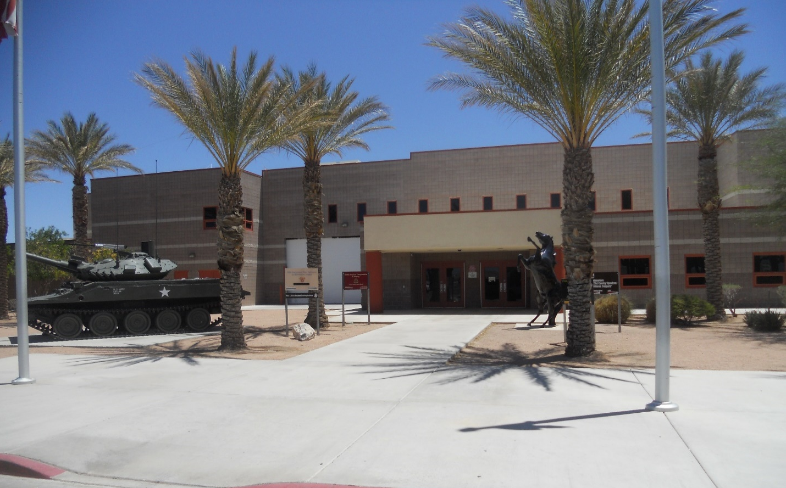
Covered Patio (Clark County Readiness Center) ID # 19130
Justification:
Currently there is no outside break area. This would provide a shaded area to take breaks and eat lunch
Additionally, water intrusion occurs at a few of the exterior doors in the proposed area of the building and this would assist in diverting some of the water away from those exterior doors.
$160K
50/50
$90K State

Slide 18
Purchase of Navy Reserve Center (Stead) #21148
Justification:
Purchase and renovation of this facility of needed to support Nevada National Guard mission
$3.5M
100% State
$3.5M

Slide 19
HVAC Systems Renovation (Carlin Readiness Center) #7608
Justification:
The existing heat pumps and rooftop units are approximately 20 years old and are nearing the end of their useful life.
The equipment contains R-22 refrigerant which cannot be manufactured in, or imported to the USA as of 1/1/2020.
This project will improve energy efficiency at the facility, which will result in reduced Greenhouse Gas emissions. This supports the intent of Senate Bill 254.
$2.2M
54/44
$760k

Slide 20
Restroom and Shower Renovation (Washoe County Armory) #21131
Justification:
The fixtures and finishes are failing in this facility.
Deteriorating grout and failed drainage systems are causing water to pool and undermining the tile floor finishes and corrosion to metal framing members.
$1.2M
50/50
$700K

Slide 21
Construct Storage Buildings, Three Facilities (NNG State Maintenance) #21129
Justification:
There is currently no place on any of these sites for the maintenance staff to store large State owned equipment out of the elements.
This has led to increased costs to maintain this equipment.
Locations are OTAG in Carson City, Harry Reid Training Center in Stead, and North Las Vegas Readiness Center on Floyd Edsall Training Center
$1.7M
100% State
$1.7M

Slide 22
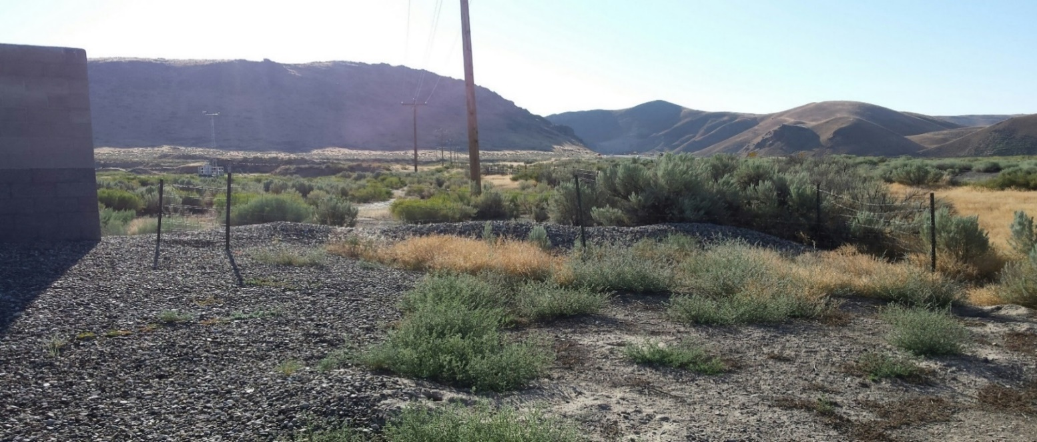
Security Fence Addition (Elko County Readiness Center) ID # 7612a
Justification:
This force protection fencing project is necessary to protect military property and to keep the public from accessing military training areas.
This project will provided a security perimeter at the facility to help protect youth in Project Challenge
This fence enclosure provides an additional level of force protection during National Guard training exercises and drills, and help ensure that live fire, small arms training is conducted within a secure controlled environment.
$1.4M
56/44
$640K State

Slide 23
Recondition Water Tank (Elko County Readiness Center) ID # 7595
Justification:
The water tank supplies domestic water to the entire site and hasn’t had a significant service since before the National Guard took possession of the site.
The tank will provide water for the Battle Born Youth Challenge program
If not reconditioned, the tank will continue to deteriorate resulting in no source of potable water on the site.
$600K
56/44
$270K state

Slide 24
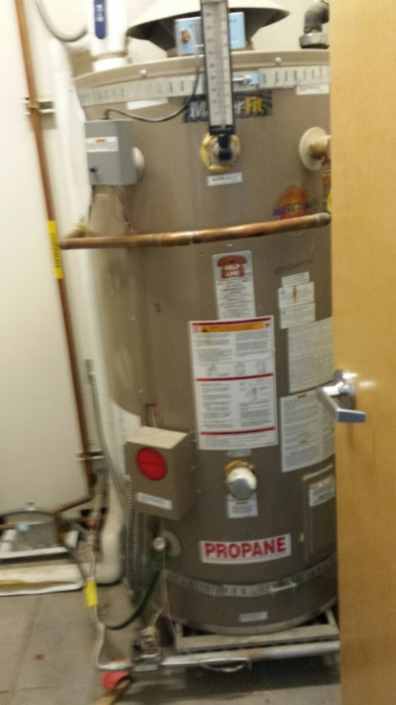
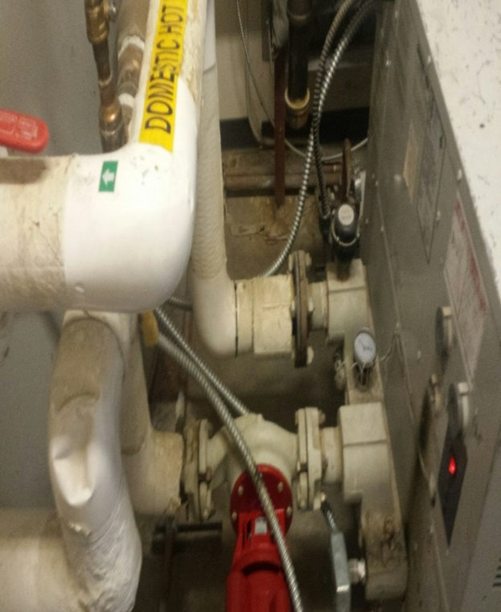
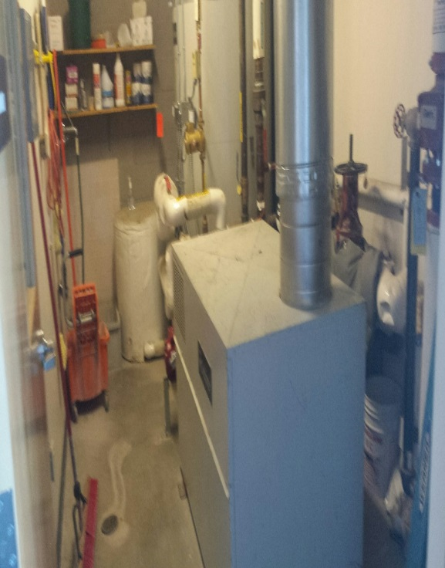
Replace Domestic Water Heaters (Elko County Readiness Center) ID # 7611
Justification:
The existing domestic hot water heaters are more than 20 years old and are nearing the end of their useful life.
This project will improve energy efficiency at the facility, which will result in reduced Greenhouse Gas emissions. This
supports the intent of Senate Bill 254
$1.02M
56/44
$470K State

